Slide 1
Unsupervised Anomaly Detection

Slide 2
Outline
Introduction
Evaluation Methods
Dataset
EDA
Anomaly Detection Algorithms
Model Results
Visualization of Results
Conclusion

Slide 3
Introduction
Identifying unexpected items or events in datasets
UNSW-NB15 dataset of network attacks
A hybrid of real modern normal activities and synthetic contemporary attack behaviours.
49 features and 700000 observations
Anomaly labels and attack types are included
We applied unsupervised methods
Isolation Forest
Local Outlier Factor
DBScan

Slide 4
Evaluation Methods
Supervised Methods
Recall Score
Precision
Unsupervised Methods
Silhouette Score: a measure of distance of a single sample between other points within the cluster and with the points of nearest cluster
calinski_harabasz_score: ratio between the within-cluster dispersion and the between-cluster dispersion.dispersion is defined as the sum of distances squared
davies_bouldin_score: average similarity measure of each cluster with its most similar cluster. clusters which are farther apart and less dispersed will result in a better score.

Slide 5
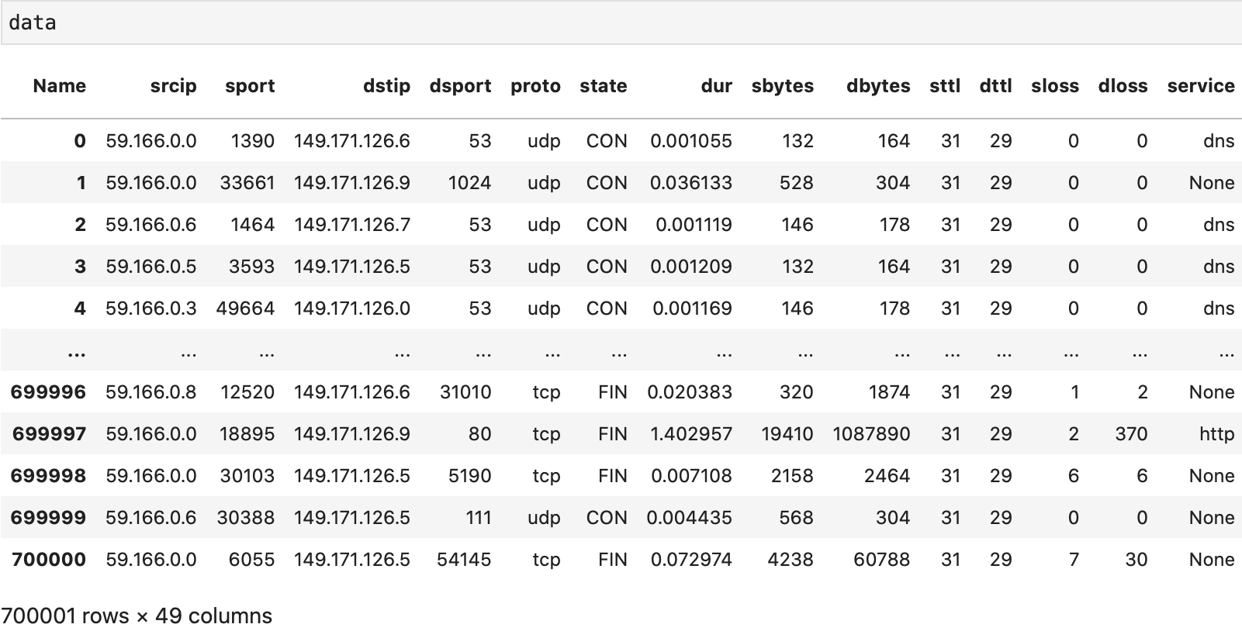
Dataset

Slide 6
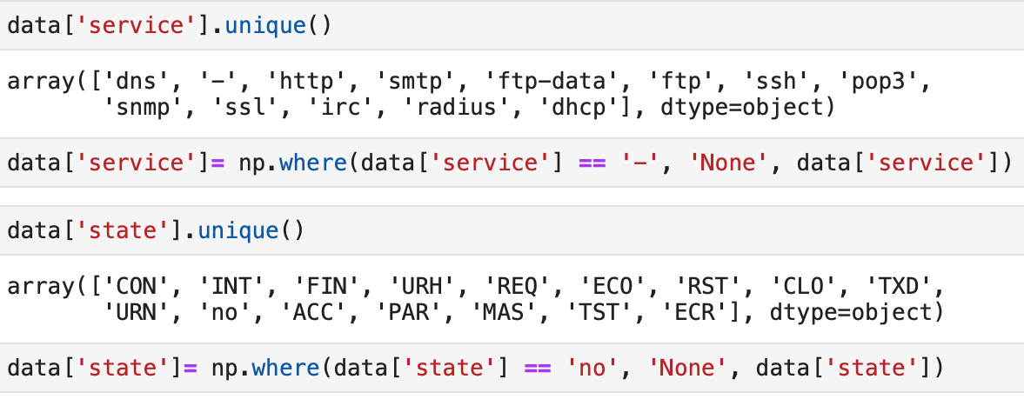
Data Preprocessing

Slide 7
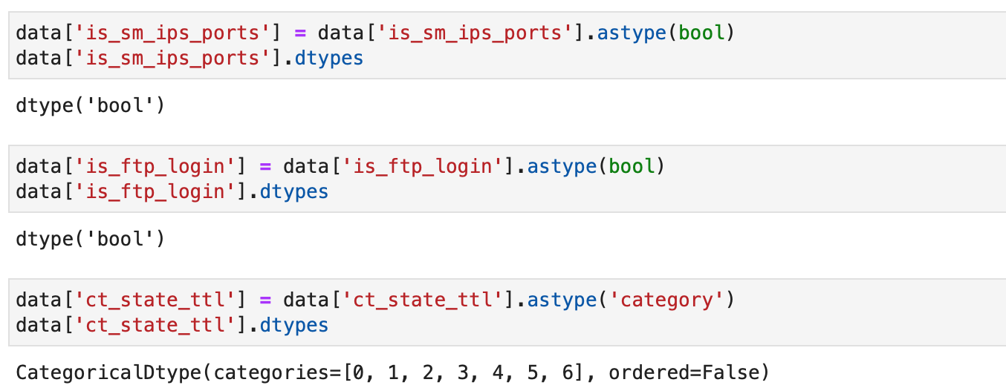
Data Preprocessing

Slide 8

Data Preprocessing

Slide 9
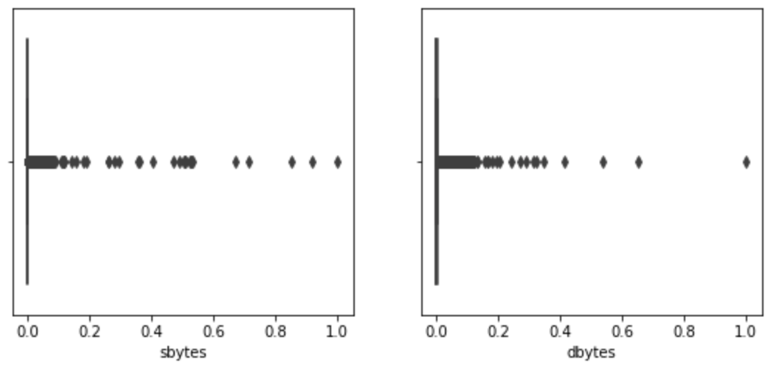
Univariate Data Analysis

Slide 10
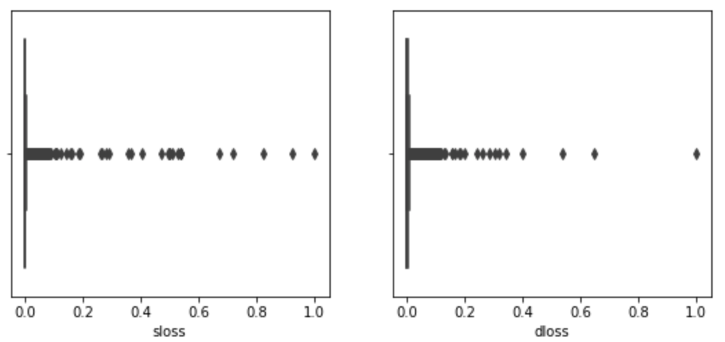
Univariate Data Analysis

Slide 11
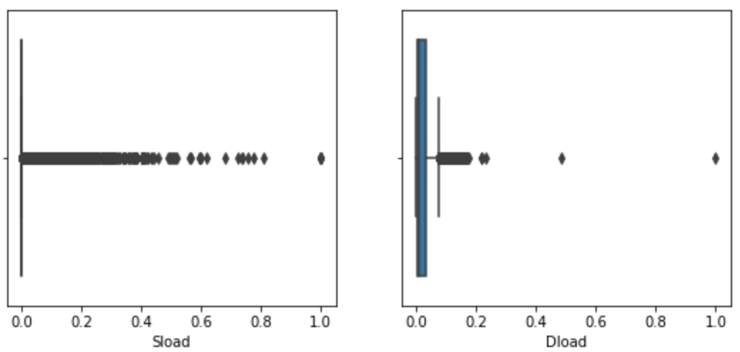
Univariate Data Analysis

Slide 12
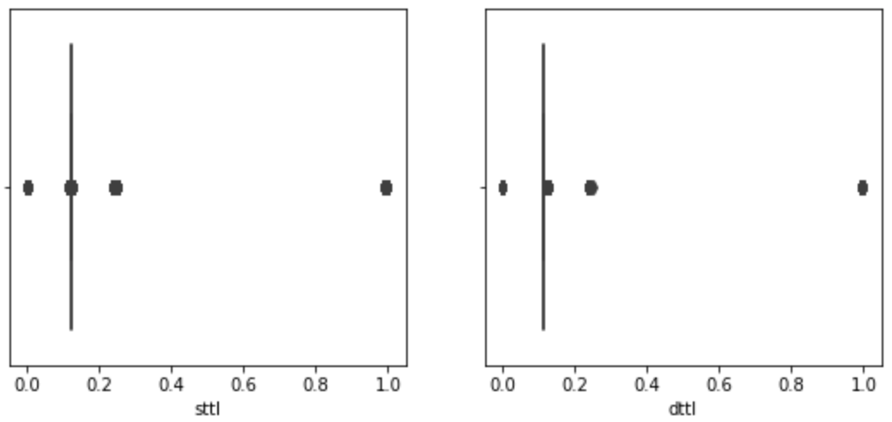
Univariate Data Analysis

Slide 13
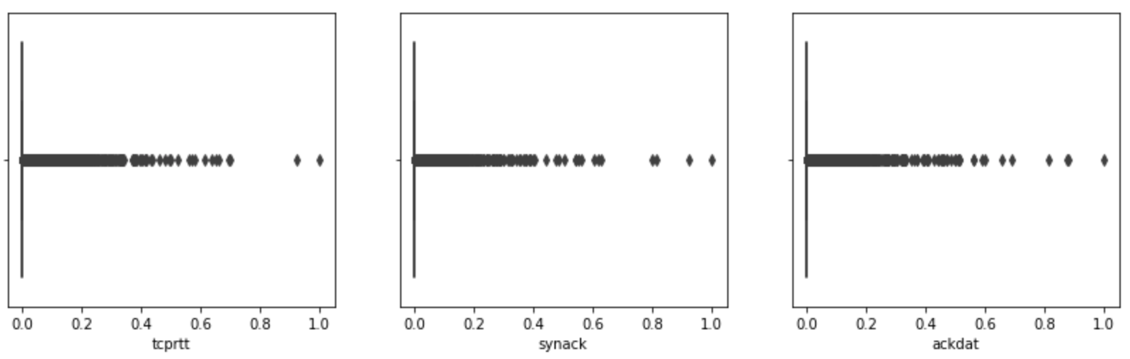
Univariate Data Analysis

Slide 14
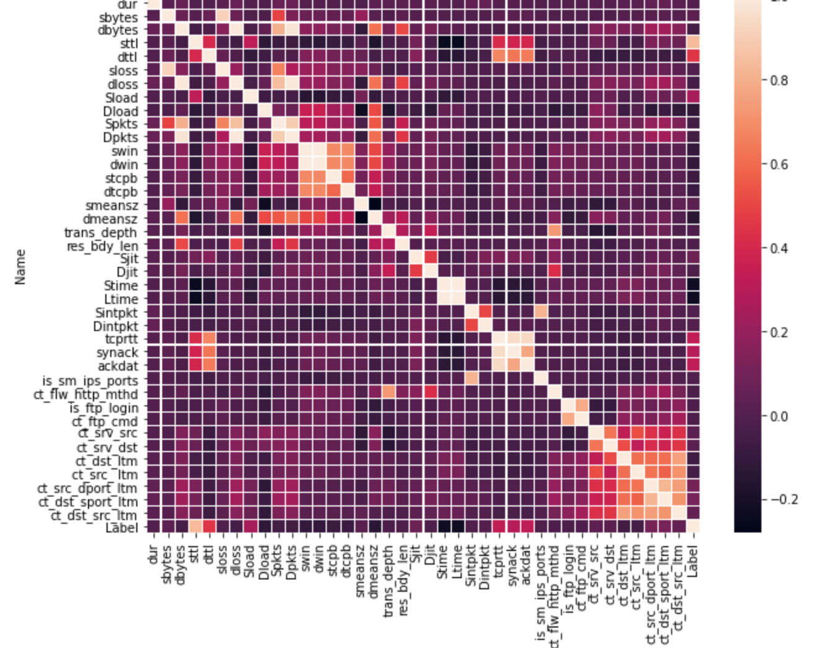

Slide 15
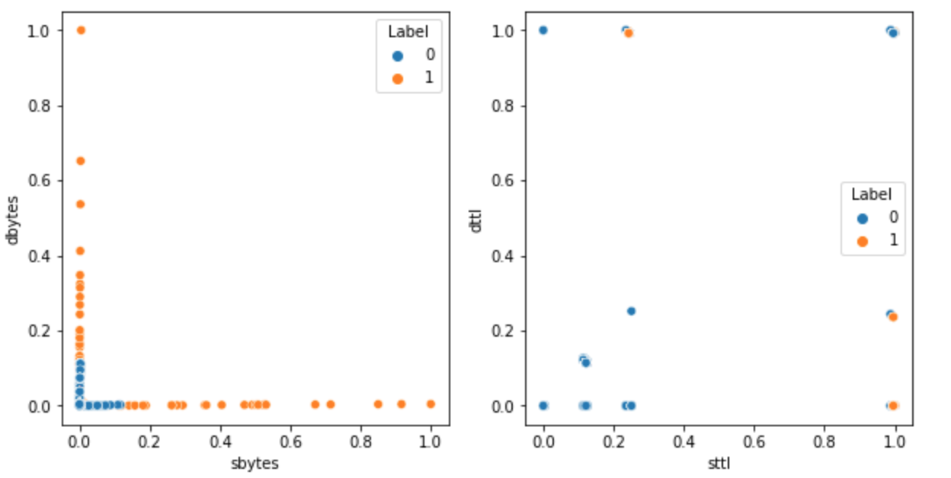
Bivariate Feature Analysis

Slide 16
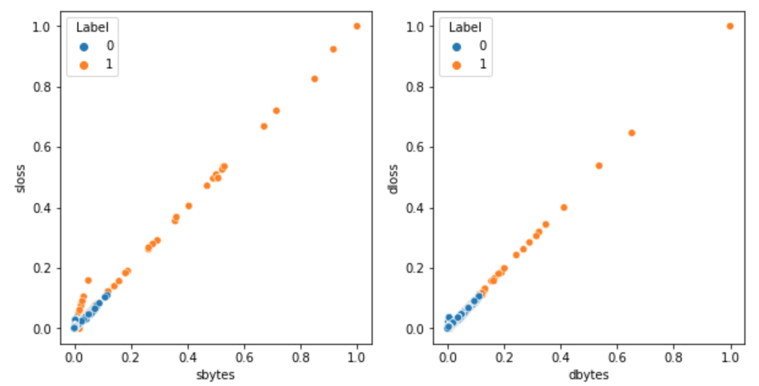
Bivariate Feature Analysis

Slide 17
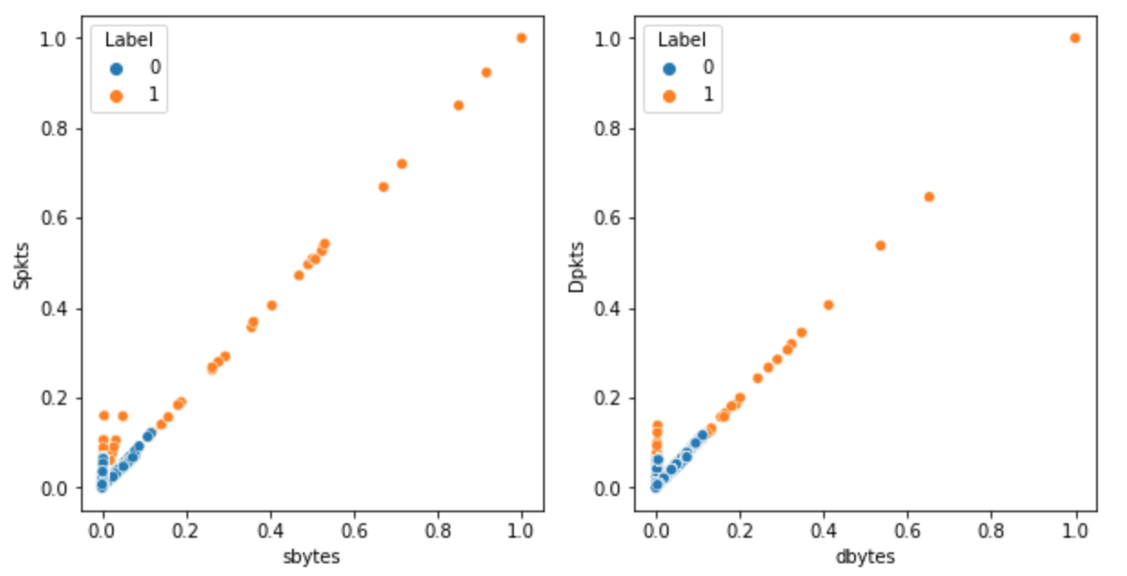
Bivariate Feature Analysis

Slide 18
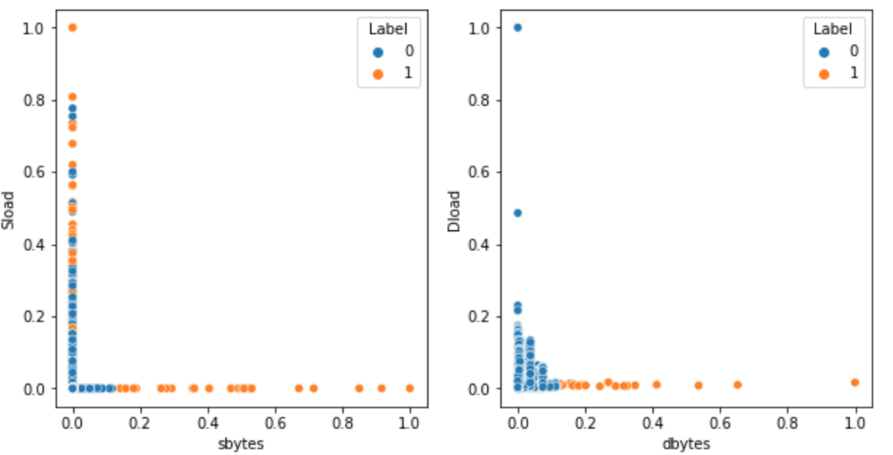
Bivariate Feature Analysis

Slide 19
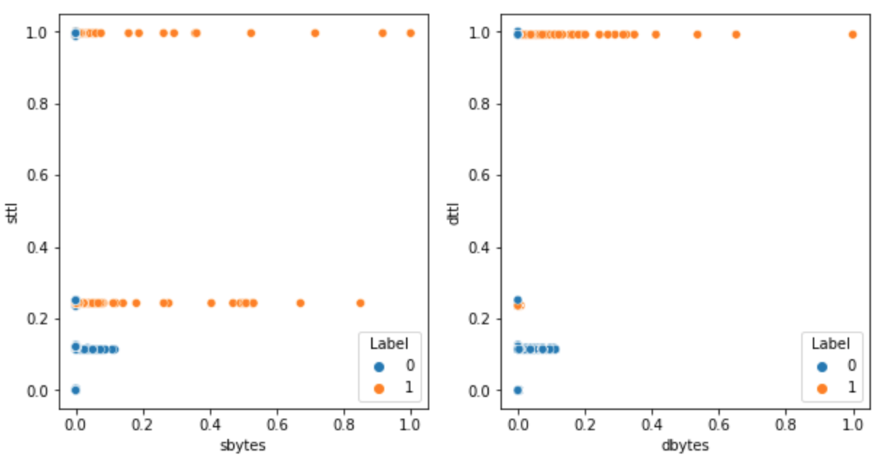
Bivariate Feature Analysis

Slide 20
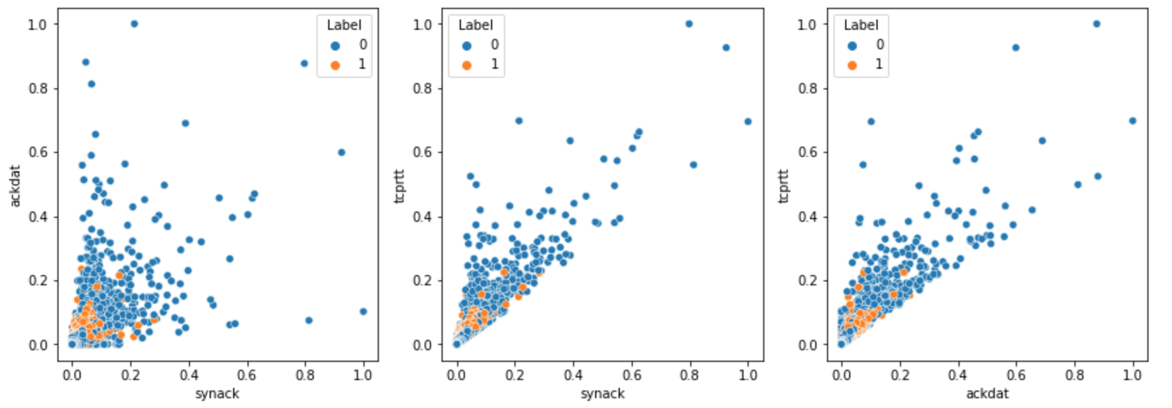
Bivariate Feature Analysis

Slide 21
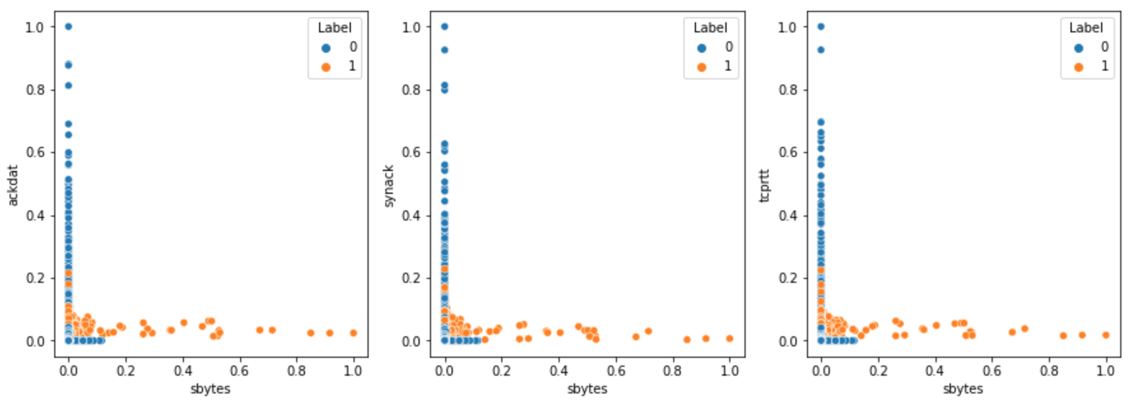
Bivariate Feature Analysis

Slide 22
Experiments
Full Model: All features included
Selected Model: 'sttl', 'sbytes', 'smeansz', 'ct_dst_sport_ltm', ‘service’
Model 1:'sbytes', 'sttl'
Model 2:'sbytes', 'sttl', 'dttl'
Model 3:'sbytes', 'sttl','tcprtt','synack'
Model 4:'sbytes', 'sttl','tcprtt','synack', 'ackdat'
Model 5: 'sbytes', 'sttl','tcprtt','synack', 'ackdat', 'Sload'

Slide 23
Isolation Forest
Tree Ensemble Method
Main idea behind:
anomalies are rare, less frequent than normals
anomalies are different than normals
Randomly selecting a feature and randomly selecting a value
Decision Function: Length of the path to isolate a single point at the end node
Anomaly points have shorter path length than normal points

Slide 24
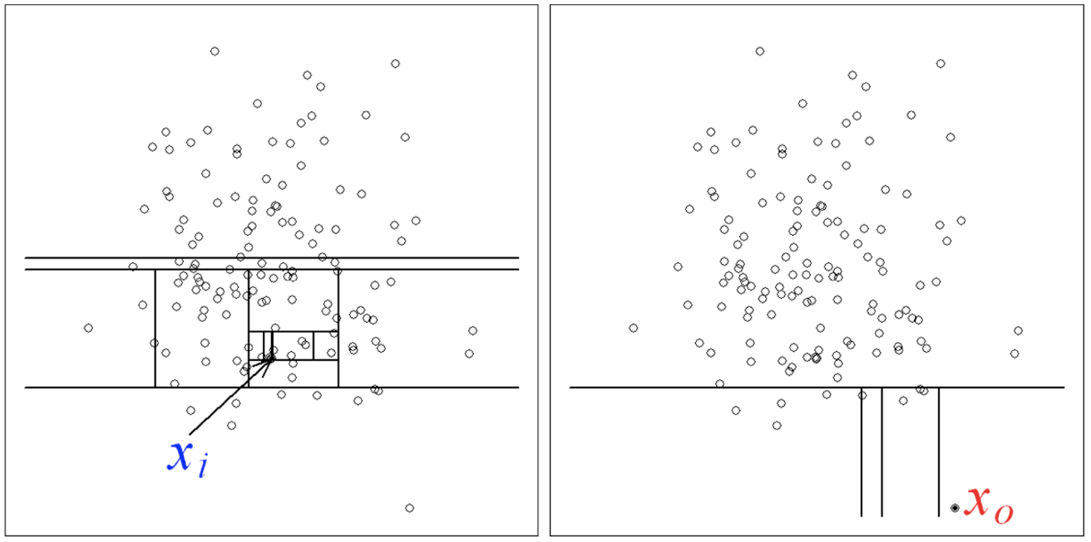
Isolation Forest

Slide 25
Isolation Forest Model
Model | Recall | Prediction | Davies_bouldin | Calinski
Full Model | 0.89 | 0.36 | 4.032 | 14814.348
Selected Model | 0.67 | 0.16 | 3.399 | 34444.326
Model1 | 1 | 0.21 | 1.521 | 170577.335
Model2 | 1 | 0.21 | 1.806 | 118616.591
Model3 | 0.998 | 0.34 | 1.211 | 388570.030
Model4 | 0.99 | 0.46 | 0.989 | 655861.022
Model5 | 0.99 | 0.39 | 1.080 | 528545.852

Slide 26
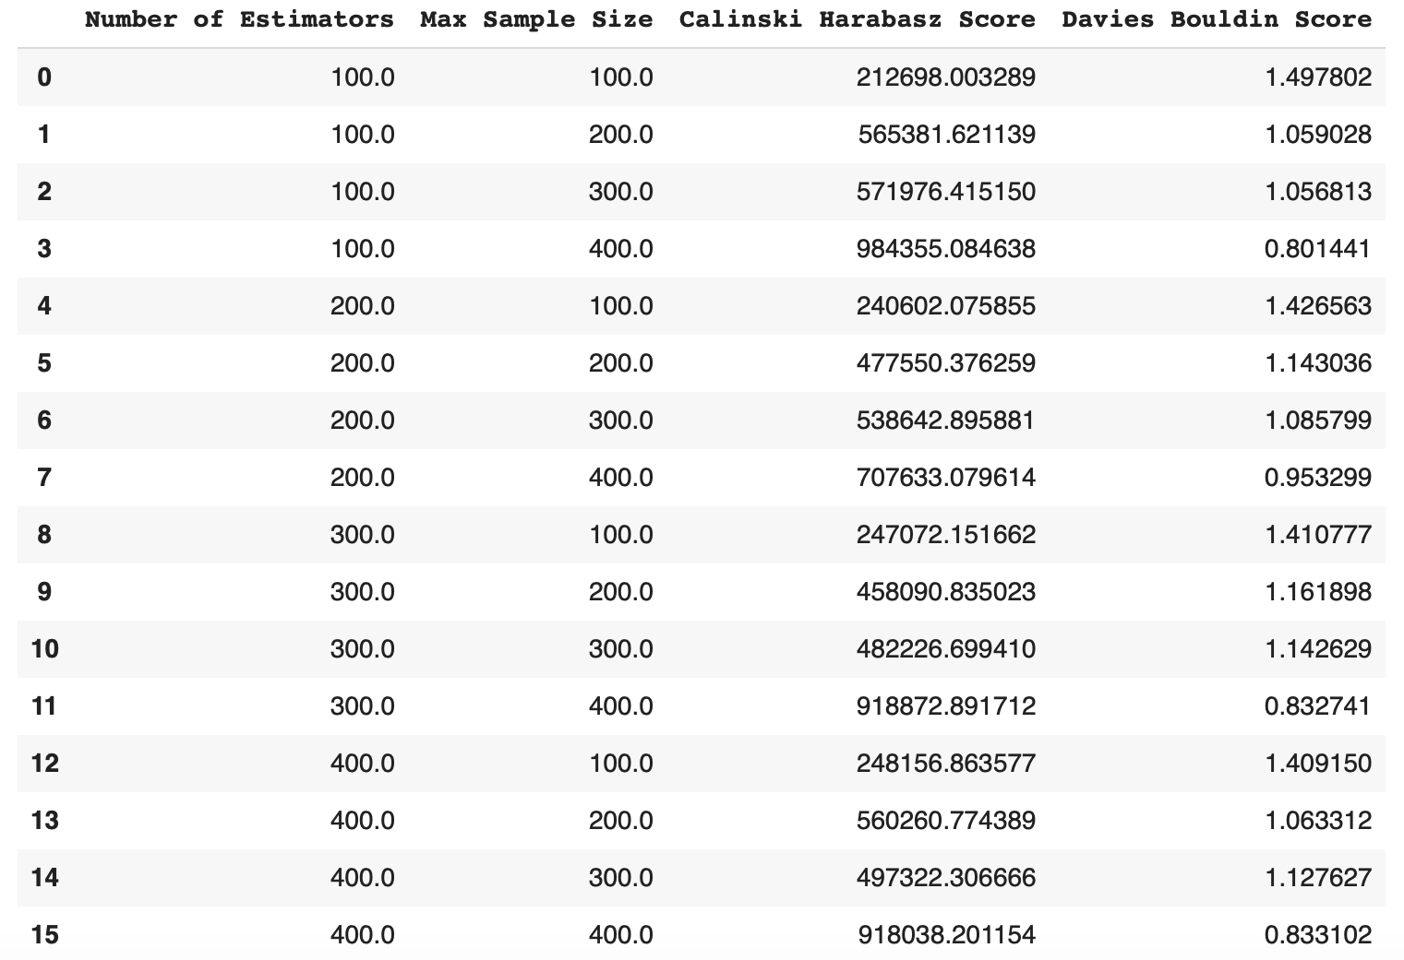
Iso-Forest: Hyperparameter Tuning

Slide 27
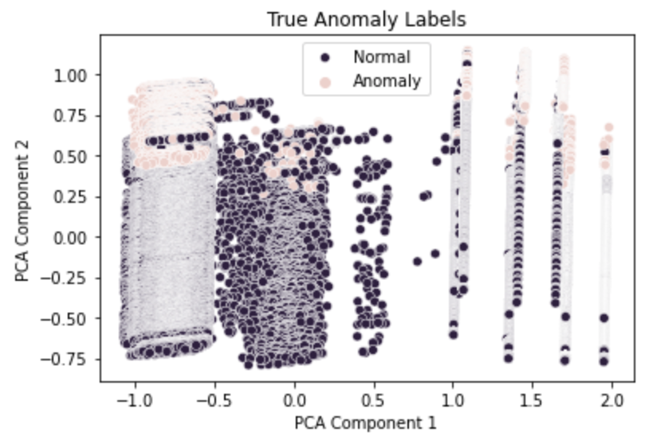
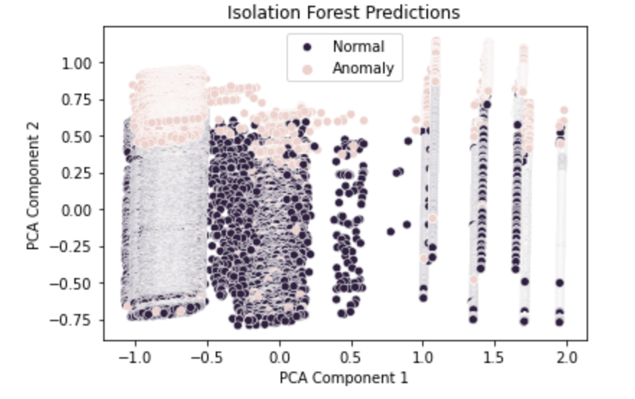
Visualization of Results
Isolation Forest

Slide 28
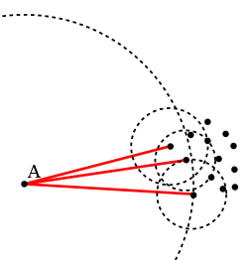
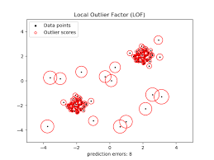
Local Outlier Factor
Based on the concept of a local density
Locality is given by k nearest neighbors
Comparing the local density of an object to the local densities of its neighbors
Points that have a substantially lower density than their neighbors are considered to be outliers.

Slide 29
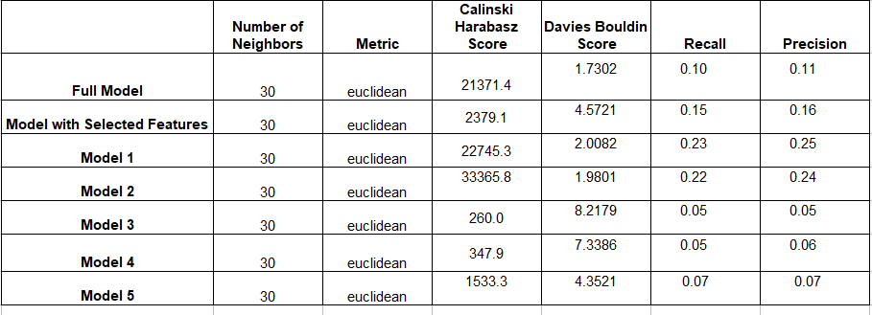
Local Outlier Factor

Slide 30
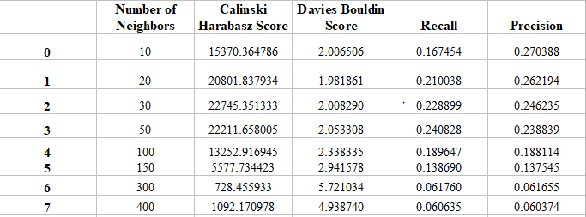
LOF-Hyperparameter Tuning

Slide 31
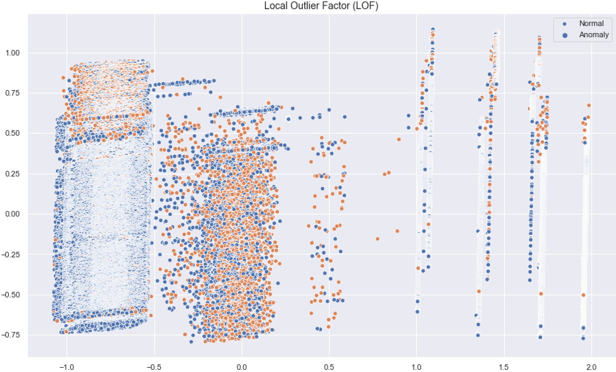
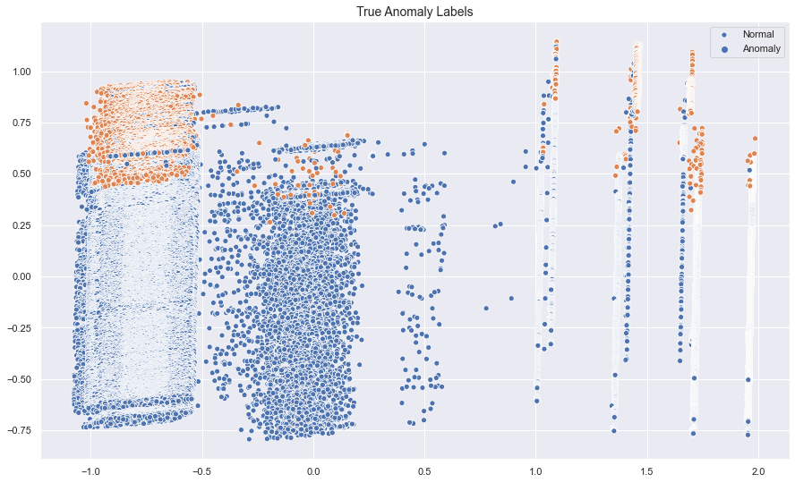
Visualization of Results
Local Outlier Factor

Slide 32
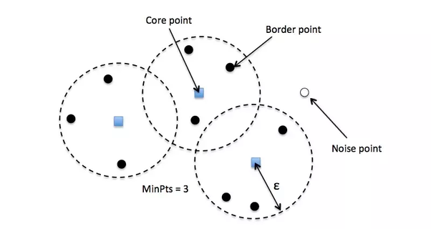
DBScan
a density based clustering algorithm
divide observations into subgroups of high density regions
need to tune two parameters:
epsilon (ϵ): the distance parameter
minimum number of points for a cluster
one of the most efficient and fastest clustering algorithms.

Slide 33
DBScan
Model | Recall | Precision | Davies bouldin | Calinski
Full Model | 0,47 | 0,53 | 3,5 | 663
Selected Model | 0 | 1 | 0,19 | 75
Model 1 | 0 | 1 | 0,22 | 54
Model 2 | 0 | 1 | 0,22 | 48
Model 3 | 0 | 0,57 | 1,11 | 84
Model 4 | 0 | 0,44 | 1,05 | 134
Model 5 | 0 | 0,27 | - | -
Best Model | 0,94 | 0,095 | 0,76 | 22644

Slide 34
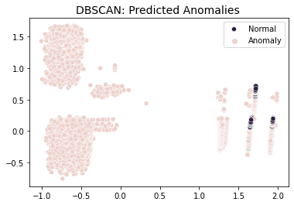
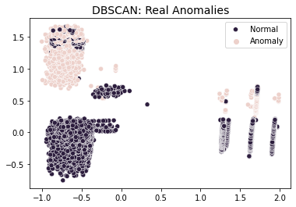
Visualization of Results

Slide 35
Conclusion
Algorithm | Model | Parameters | Recall | Precision | Calinski | Davies
Iso Forest | Model 4 | n_estimators = 90 max_samples= 500 | 0.9953 | 0.6046 | 1242646 | 0.7
LOF | Model 1 | Number of Neighbors = 50 Metric = euclidean | 0.22 | 0.25 | 33365 | 1.9
DBScan | Full model | ϵ = 0.2 max:samples= 130 | 0.94 | 0.095 | 22644 | 0.76

